Slide 1
Chapter 3 Problem Solving By Searching

Slide 2
Problem-Solving Agents
Intelligent agents can solve problems by searching a state-space
State-space Model
the agent’s model of the world
usually a set of discrete states
e.g., in driving, the states in the model could be towns/cities
Goal State(s)
a goal is defined as a desirable state for an agent
there may be many states which satisfy the goal test
e.g., drive to a town with a ski-resort
or just one state which satisfies the goal
e.g., drive to Mammoth
Operators (actions, successor function)
operators are legal actions which the agent can take to move from one state to another

Slide 3
Initial Simplifying Assumptions
Environment is static
no changes in environment while problem is being solved
Environment is observable
Environment and actions are discrete
(typically assumed, but we will see some exceptions)
Environment is deterministic

Slide 4
Example: Traveling in Romania
On holiday in Romania; currently in Arad
Flight leaves tomorrow from Bucharest
Formulate goal:
be in Bucharest
Formulate problem:
states: various cities
actions/operators: drive between cities
Find solution
By searching through states to find a goal
sequence of cities, e.g., Arad, Sibiu, Fagaras, Bucharest
Execute states that lead to a solution

Slide 5
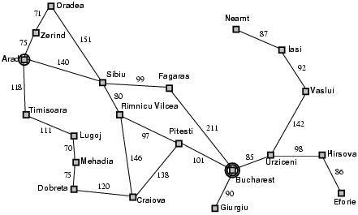
Example: Traveling in Romania

Slide 6
State-Space Problem Formulation
A problem is defined by four items:
initial state e.g., "at Arad“
actions or successor function
S(x) = set of action–state pairs e.g., S(Arad) = {<Arad → Zerind, Zerind>, … }
3. goal test (or set of goal states)
e.g., x = "at Bucharest”, Checkmate(x)
4. path cost (additive)
e.g., sum of distances, number of actions executed, etc.
c(x,a,y) is the step cost, assumed to be ≥ 0
A solution is a sequence of actions leading from the initial state to a goal state

Slide 7
Example: Formulating the Navigation Problem
Set of States
individual cities
e.g., Irvine, SF, Las Vegas, Reno, Boise, Phoenix, Denver
Operators
freeway routes from one city to another
e.g., Irvine to SF via 5, SF to Seattle, etc
Start State
current city where we are, Irvine
Goal States
set of cities we would like to be in
e.g., cities which are closer than Irvine
Solution
a specific goal city, e.g., Boise
a sequence of operators which get us there,
e.g., Irvine to SF via 5, SF to Reno via 80, etc

Slide 8
Abstraction
Definition of Abstraction:
Process of removing irrelevant detail to create an abstract representation: ``high-level”, ignores irrelevant details
Navigation Example: how do we define states and operators?
First step is to abstract “the big picture”
i.e., solve a map problem
nodes = cities, links = freeways/roads (a high-level description)
this description is an abstraction of the real problem
Can later worry about details like freeway onramps, refueling, etc
Abstraction is critical for automated problem solving
must create an approximate, simplified, model of the world for the computer to deal with: real-world is too detailed to model exactly
good abstractions retain all important details

Slide 9
The State-Space Graph
Graphs:
nodes, arcs, directed arcs, paths
Search graphs:
States are nodes
operators are directed arcs
solution is a path from start S to goal G
Problem formulation:
Give an abstract description of states, operators, initial state and goal state.
Problem solving:
Generate a part of the search space that contains a solution

Slide 10
The Traveling Salesperson Problem
Find the shortest tour that visits all cities without visiting any city twice and return to starting point.
State: sequence of cities visited
S₀ = A
C
B
A
D
F
E
G = a complete tour

Slide 11
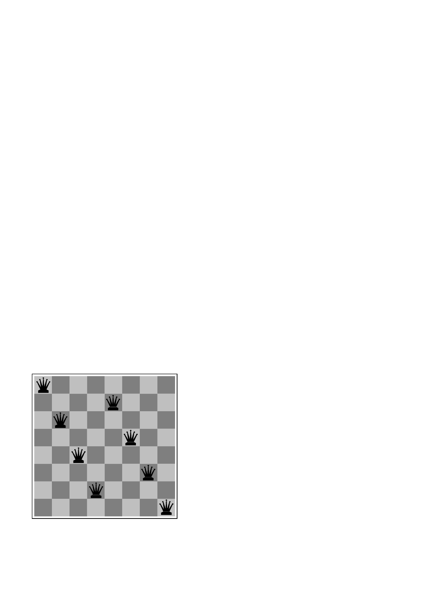
Example: 8-queens problem

Slide 12

State-Space problem formulation
states? -any arrangement of n<=8 queens
-or arrangements of n<=8 queens in leftmost n
columns, 1 per column, such that no queen
attacks any other.
initial state? no queens on the board
actions? -add queen to any empty square
-or add queen to leftmost empty square such that it is not attacked by other queens.
goal test? 8 queens on the board, none attacked.
path cost? 1 per move

Slide 13
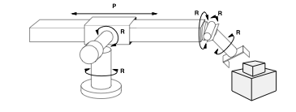
Example: Robot Assembly
States
Initial state
Actions
Goal test
Path Cost

Slide 14
Example: Robot Assembly
States: configuration of robot (angles, positions) and object parts
Initial state: any configuration of robot and object parts
Actions: continuous motion of robot joints
Goal test: object assembled?
Path Cost: time-taken or number of actions

Slide 15
Learning a spam email classifier
States
Initial state
Actions
Goal test
Path Cost

Slide 16
Learning a spam email classifier
States: settings of the parameters in our model
Initial state: random parameter settings
Actions: moving in parameter space
Goal test: optimal accuracy on the training data
Path Cost: time taken to find optimal parameters
(Note: this is an optimization problem – many machine learning problems can be cast as optimization)

Slide 17
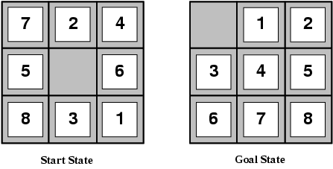
Example: 8-puzzle
states?
initial state?
actions?
goal test?
path cost?

Slide 18
Example: 8-puzzle
states? locations of tiles
initial state? given
actions? move blank left, right, up, down
goal test? goal state (given)
path cost? 1 per move

Slide 19
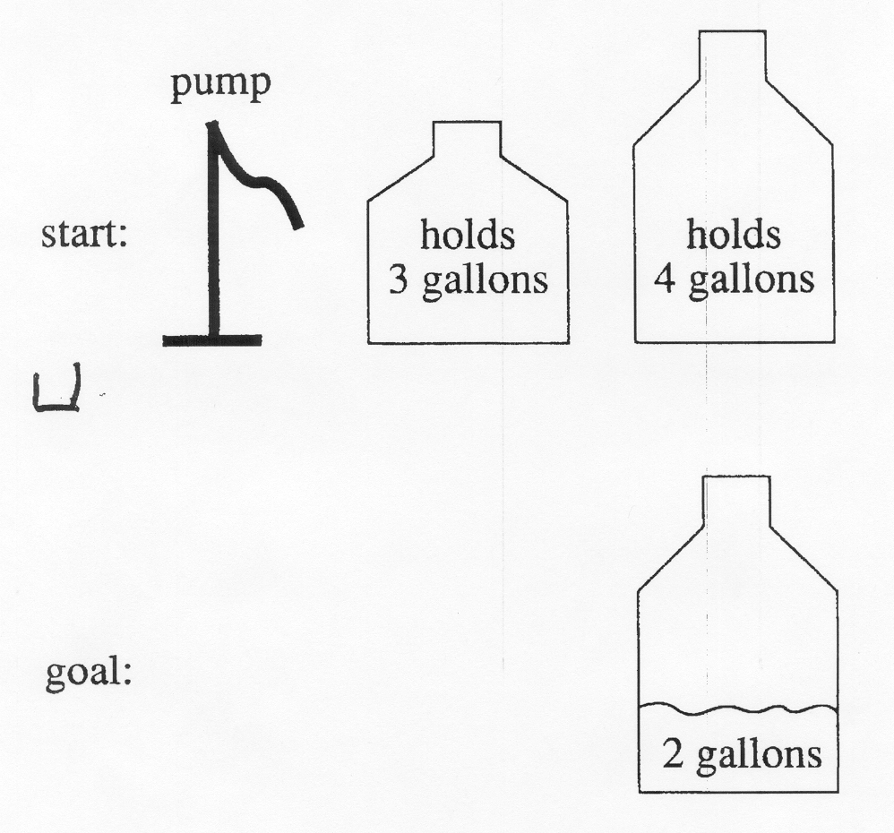
A Water Jug Problem
You have a 4-gallon and a 3-gallon water jug
You have a faucet with an unlimited amount of water
You need to get exactly 2 gallons in 4-gallon jug

Slide 20
Puzzle-solving as Search
State representation: (x, y)
x: Contents of four gallon
y: Contents of three gallon
Start state: (0, 0)
Goal state (2, n)
Operators
Fill 3-gallon from faucet, fill 4-gallon from faucet
Fill 3-gallon from 4-gallon , fill 4-gallon from 3-gallon
Empty 3-gallon into 4-gallon, empty 4-gallon into 3-gallon
Dump 3-gallon down drain, dump 4-gallon down drain

Slide 21
Production Rules for the Water Jug Problem
1 (x,y) → (4,y)
if x < 4
2 (x,y) → (x,3)
if y < 3
3 (x,y) → (x – d,y)
if x > 0
4 (x,y) → (x,y – d)
if x > 0
5 (x,y) → (0,y)
if x > 0
6 (x,y) → (x,0)
if y > 0
7 (x,y) → (4,y – (4 – x))
if x + y ≥ 4 and y > 0
Fill the 4-gallon jug
Fill the 3-gallon jug
Pour some water out of the 4-gallon jug
Pour some water out of the 3-gallon jug
Empty the 4-gallon jug on the ground
Empty the 3-gallon jug on the ground
Pour water from the 3-gallon jug into the 4-gallon jug until the 4-gallon jug is full

Slide 22
The Water Jug Problem (cont’d)
8 (x,y) → (x – (3 – y),3)
if x + y ≥ 3 and x > 0
9 (x,y) → (x + y, 0)
if x + y ≤ 4 and y > 0
10 (x,y) → (0, x + y)
if x + y ≤ 3 and x > 0
Pour water from the 4-gallon jug into the 3-gallon jug until the 3-gallon jug is full
Pour all the water from the 3-gallon jug into the 4-gallon jug
Pour all the water from the 4-gallon jug into the 3-gallon jug

Slide 23
One Solution to the Water Jug Problem
Gallons in the 4-Gallon Jug | Gallons in the 3-Gallon Jug | Rule Applied
0 | 0 | 2
0 | 3 | 9
3 | 0 | 2
3 | 3 | 7
4 | 2 | 5
0 | 2 | 9
2 | 0

Slide 24
VLSI Layout Problem
Require positioning millions of components and connections on a chip to minimize area, minimize circuit delays, minimize stray capacitances, and maximize manufacturing yield
The layout problem comes after the logical design phase and is usually split into two parts: cell layout and channel routing
In cell layout, the primitive components of the circuit are grouped into cells, each of which performs some recognized function

Slide 25
VLSI Layout Problem (cont’d)
Each cell has a fixed footprint (size and shape) and requires a certain number of connections to each of the other cells
The aim is to place the cells on the chip so that they do not overlap and so that there is room for the connecting wires to be placed between the cells
Channel routing finds a specific route for each wire through the gaps between the cells. These search problems are extremely complex, but definitely worth solving.

Slide 26
Next Topics
Uninformed search
Breadth-first, depth-first
Uniform cost
Iterative deepening
Informed (heuristic) search
Greedy best-first
A*
Memory-bounded heuristic search
And more….
Local search and optimization
Hill-climbing
Simulated annealing
Genetic algorithms

Slide 27
Summary
Problem-solving agents where search consists of
state space
operators
start state
goal states
Abstraction and problem formulation

